Slide 1
Brucellosis
Power Point By Brittney Wilson

Slide 2
What is
Brucellosis?
Brucellosis is an infectious disease caused by the bacteria of the genus Brucella.
Brucella canis is a zoonotic organism, although disease appears to be rare in humans.
Zoonotic diseases are diseases caused by infectious agents that can be transmitted between (or are shared by) animals and humans

Slide 3
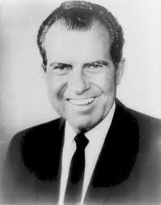
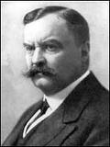
History of Brucellosis
In the United States, In the mid-20th century, Brucella was the first microorganism developed into a weapon to be used by the military. The use of brucellosis for biological warfare purposes was later banned in 1969 by President Nixon.
It was not until 1887 that a British physician, Dr. David Bruce, isolated the organism that causes brucellosis from several deceased patients from the island of Malta.
This disease has had several names throughout its history (including Mediterranean fever, Malta fever, Crimean fever, Ban’s disease and Undulant fever)
Brucellosis has been recognized in animals including humans since the 20th century, thought to have existed since ancient times, as it was first described by the Romans more than 2,000 years ago.

Slide 4
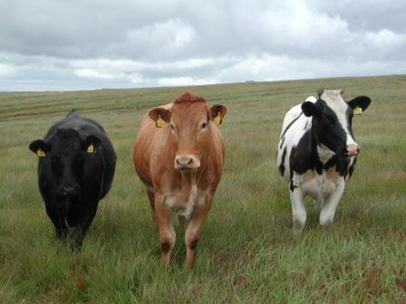
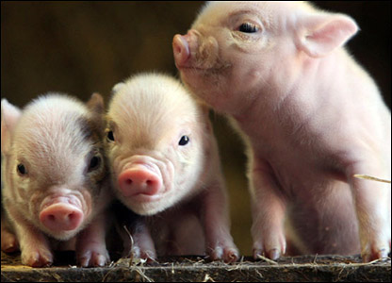
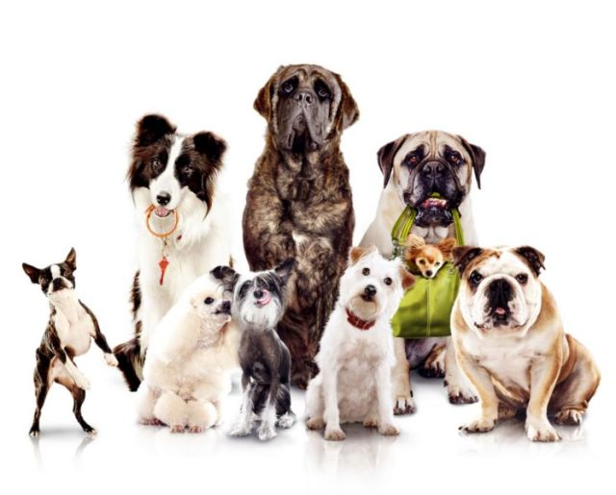
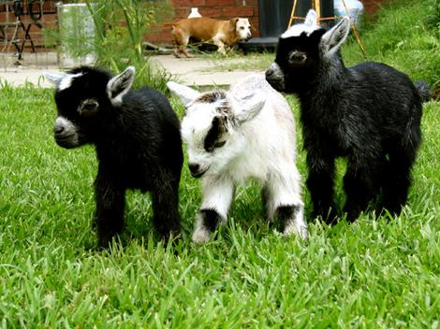
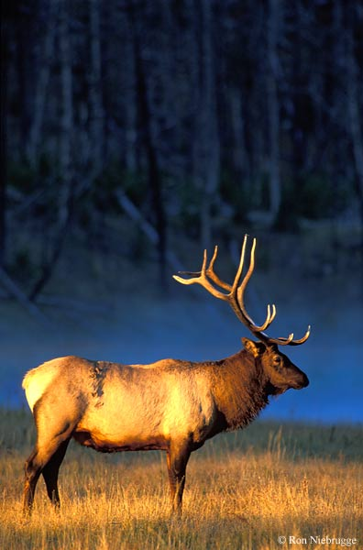
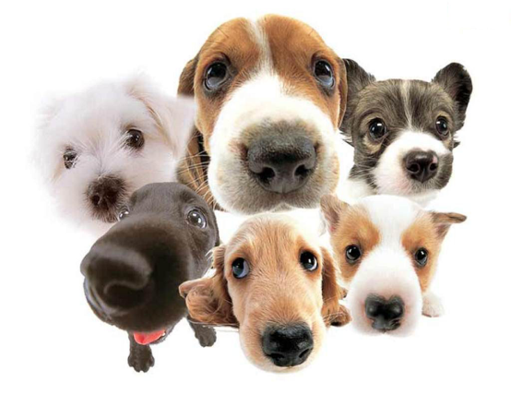
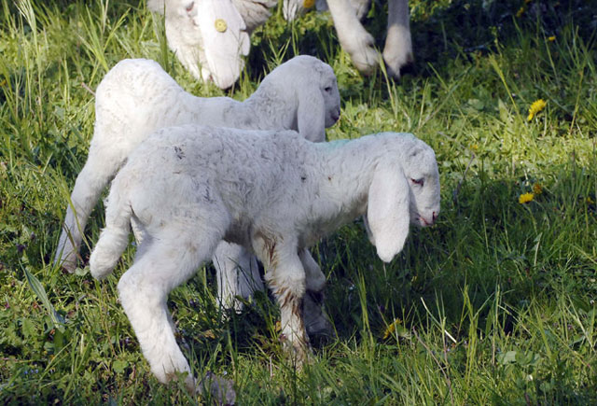
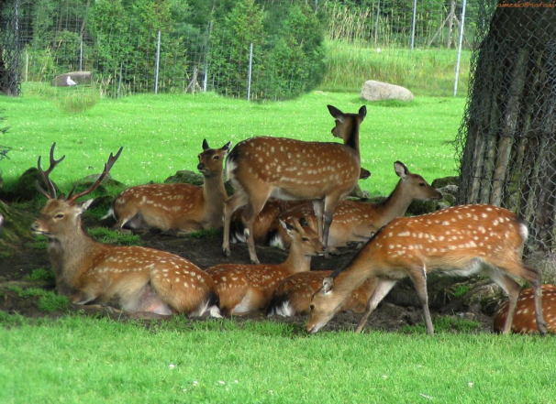
It is found all over the world infecting many different types of mammals
Some specific species affected include:
sheep, goats, cattle, deer, elk, pigs, dogs, and several other animals.

Slide 5
Brucellosis
Bacteria primarily passed among animals, and they cause disease in many different vertebrates. Canine brucellosis, caused by Brucella canis, is an important cause of reproductive failure, particularly in kennels. B. abortus causes abortions, stillbirths, epididymitis, orchitis and sperm abnormalities in dogs.

Slide 6
There are five Brucella bacteria each causing a different form of the disease.
(Plus a recently discovered one)
Brucella ovis –
affects sheep, causing ovine brucellosis.
Ovine brucellosis is not known to cause disease in humans.
Brucella abortus-
cattle, causing bovine brucellosis (contagious abortion) - sometimes affects horses
Brucella canis –
affects dogs,
causing canine brucellosis.
Brucella suis –
affects pigs, causing swine brucellosis - it has also been isolated from horses.
Brucella melintensis-
mainly affects female goats, causing caprine brucellosis - can also affect female sheep.
B. Neotomae –
Recently new species were discovered, in marine mammals

Slide 7
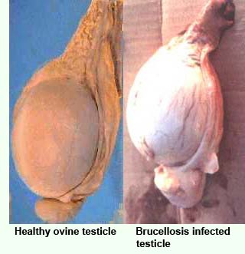
Brucella ovis
Affects sheep, causing ovine brucellosis.
Ovine brucellosis is not known to cause disease in humans.
Before a flock can be accredited as being ‘free of ovine brucellosis’ all rams and teasers over six months of age must be blood tested twice and found negative on both occasions. The interval between the two tests must be between 2 &5 months.
If tested negative, then the flock can become accredited. For a flock to maintain an ‘ovine brucellosis free’ status, all rams eligible for testing must be reassessed every 2 years following initial accreditation.
Rams introduced from non-accredited flocks must be isolated for six weeks and then pass a blood test before joining the rest of the flock.
Brucella Ovis is an infection of the genital tract that may cause lesions which affects the quality of the semen and the fertility of the effected ram.
The organism can enter the body through any mucous membrane.

Slide 8
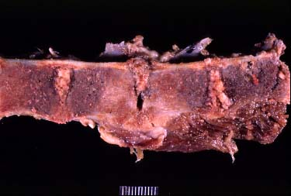
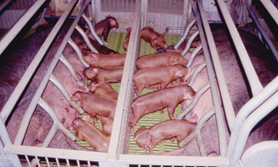
Brucella suis - affects pigs, causing swine brucellosis
- it has also been isolated from horses.
The skeleton (including joints and intervertebral discs as shown here) is often infected by Brucella suis in pigs.
The same is true in dogs with Brucella canis.
The most common symptom is abortion in pregnant susceptible hosts at any stage of gestation.
Other manifestations are temporary or permanent sterility, lameness, posterior paralysis, spondylitis, and abscess formation. It is transmitted mainly by ingestion of infected tissues or fluids, semen during breeding, and suckling infected animals.
The disease typically causes chronic inflammatory lesions in the reproductive organs of susceptible animals or orchitis and may even affect joints and other organs.
Orchitis – Condition of the testes involving inflammation &can also involve swelling and frequent infection
Spondylitis – is an inflammation of the vertebra .

Slide 9
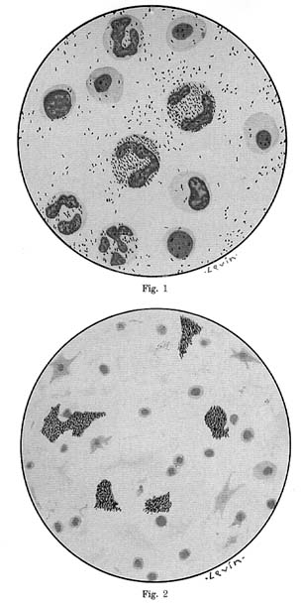
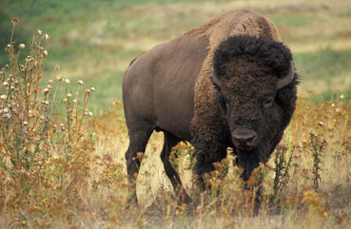
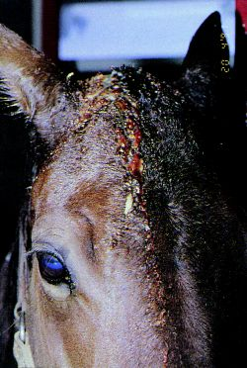
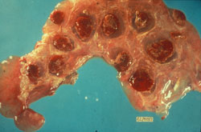
Brucella abortus- cattle, causing bovine brucellosis (contagious abortion)
- sometimes affects horses
B. abortus can be found in wildlife hosts in some regions, including the Greater Yellowstone Area of North America.
Bovine Placenta
The placenta contains numerous hemorrhagic cotyledons.
In humans this disease cause both acute and chronic symptoms, but can be treated with antibiotics. Because of this economic effect on the cattle business and the disease potential in humans, the US has spent close to $3.5 billion trying to vaccinate the cattle herds in the US . It is possible for B. abortus to be spread from wild populations of elk and bison into domestic cattle herds and this is why the US government continues to be vigilant in tracking potential cases within herds.
Poll Evil - a condition of horses involving inflammation of the supra-atlantal bursa and infection with Brucella abortus, occasionally Brucella suis.
The bursa is swollen and painful initially and may rupture to discharge through a sinus.

Slide 10
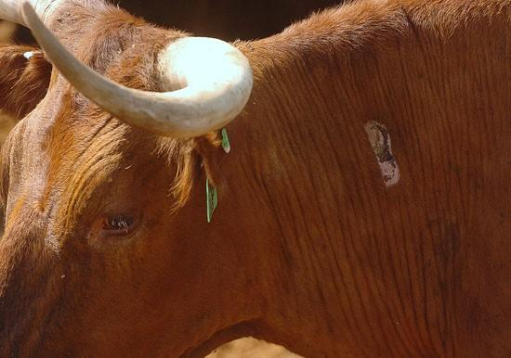
Vaccination must be done by an accredited veterinarian at calf ages that vary from two to four months using standard dosage vaccine, or from 4 to 12 months using reduced dosage vaccine.

Slide 11
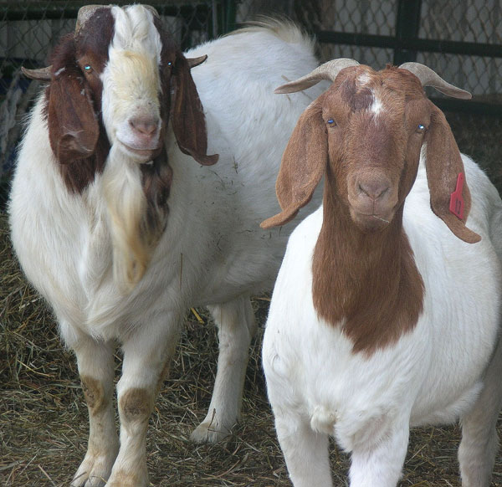
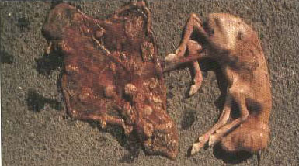
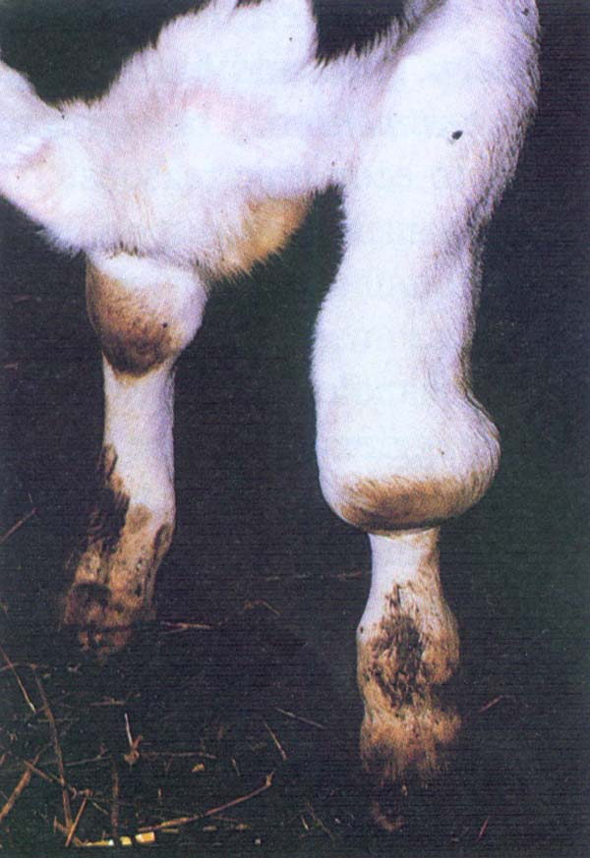
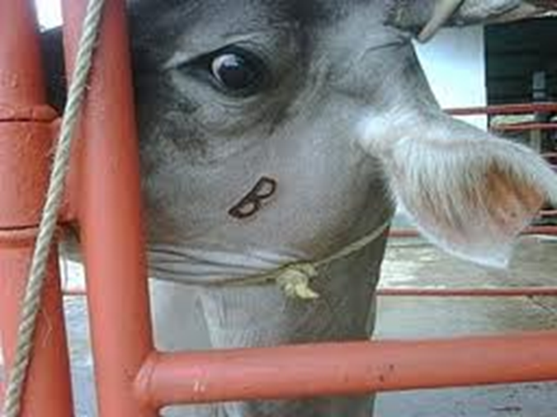
Brucella melintensis-
mainly affects female goats, causing caprine brucellosis - can also affect female sheep.
Hygromas on the knee joint
A stillbirth fetus with necrotic placenta
(death of body tissue)

Slide 12

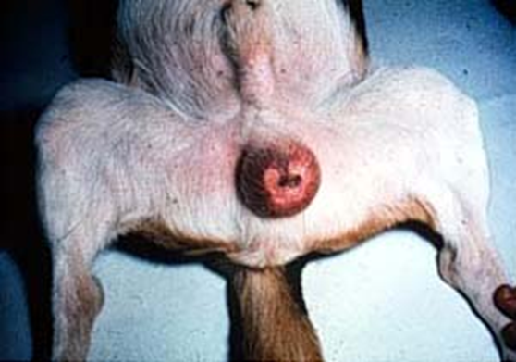
Dogs are the definitive host of this organism
The disease spreads rapidly among closely confined dogs, especially at time of breeding or when abortions occur.
Transmission occurs via ingestion of contaminated materials or venereal routes (mating).
Both sexes appear to be equally susceptible.
A primary host or definitive host is a host in which the parasite reaches maturity and can reproduces sexually.
Most veterinarians are aware of the zoonotic risks of the other Brucella species (abortus, suis, melitensis). B. canis is often overlooked due to the mild clinical signs it causes. Dogs and wild candidates are susceptible while felines are resistant.

Slide 13
Brucellosis
Canine Clinical Signs
May show mild or no clinical signs of infection.
No deaths reported with B. canis infection
Lymph node enlargement is a common finding, (affecting most lymph nodes in the body. )
The spleen and liver may also become enlarged.

Slide 14
More Canine Clinical Signs
Clinical signs may be subtle, such as poor hair coat, lack of energy, or exercise intolerance.
Arthritis may be present, especially in the back.
Recurrent eye infections may be a problem in the dog with brucellosis
Canine brucellosis should be considered when abortions and stillbirths are seen, particularly late in gestation

Slide 15
Brucella canis causes disease in the canine that is characterized by infection of the reproductive tract..
Male dogs infected with B. canis for 3 months or more usually develop antibodies that react with spermatozoa causing infertility (along with disease transmission).
Clinical signs of a male canine include epididymitis, dermatitis of the scrotum, testicular atrophy or infertility.

Slide 16
Brucellosis in Humans
Transmission of brucellosis caused by ingestion of unsterilized milk or meat from infected animals or close contact with their secretions (transmission from dogs to humans occurs but is rare)
  In humans brucellosis can cause a range of symptoms that are similar to the flu. Severe infections of the central nervous systems or lining of the heart may occur.

Slide 17
Where are you, Brucellosis?
Although brucellosis can be found worldwide, it is more common in countries that do not have good standardized and effective public health and domestic animal health programs.
Clinical disease is still common in the Middle East, Asia, Africa, South and Central America, the Mediterranean Basin and the Caribbean.
Approximately 60% of human brucellosis cases in the United States now occur in California and Texas.

Slide 18

With combination drug therapy, most recover in 2 to 3 weeks.
Even widespread infections may be cured.
Untreated, however, the infection may progress and increase in severity and also affect new tissues.
Although brucellosis can take a chronic form, with periods of illness alternating with periods of no symptoms, persistent illness lasting longer than 2 months may be due to a previously unsuspected underlying disease or a complication of the brucellosis.

Slide 19
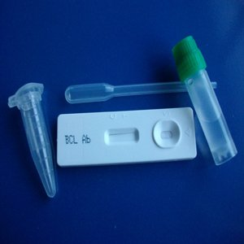
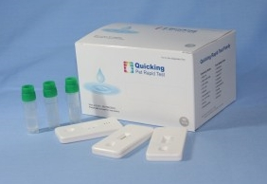
Diagnosis and Diagnostic Testing
Canine Brucella Ab
rapid test
Culture of the organism is the best means of confirmation the infection.
Blood, urine, and semen can be used for culture. However, B. canis is a difficult organism to grow. Antibody titers to B. canis are not present until 8-12 weeks post infection therefore, serologic screening is of limited use during this period.
Administering antibiotics can nullify any serologic results.
The Brucella canis antibody test kit, qualitative detection of CPV antigen. Using serum or plasma, Brucella canis antibody is quickly detected in just 10 minutes.
Brucellosis Clinical Signs:
Canine brucellosis should be considered when: abortions and stillbirths are seen, particularly late in gestation, or when male dogs develop epididymitis and testicular atrophy.

Slide 20
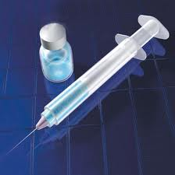
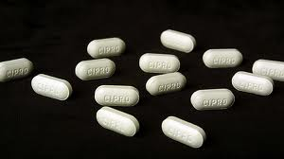
Recommended Treatment
B. canis is difficult to eradicate because the organism survives in an intracellular location. Treatment is expensive and often unsuccessful with relapses commonly occurring. In breeding kennels the infected dogs should be isolated and eliminated from breeding.
Neutering and antibiotics are the best treatment to decrease the chance of infecting others via the genital secretions.
The infection can persist in neutered animals but the risk of secretions is decreased.
Single antibiotics will not work. A combination of doxycycline with streptomycin or gentamycin or tetracycline and aminoglycosides administered for 4 weeks has shown to be successful.
With any treatment a follow up test should be performed at 1 month and 3 months post treatment to check for relapses. Treatment of canine Brucellosis will involve a round of antibiotics prescribed by a veterinarian.

Slide 21
Prevention is Key!!!
Keep your dog away from other strange dogs
For people, Gloves should be worn while handling infected material.
Breeding your dog, have a canine brucellosis test performed on both dogs.
Vaccinate!

Slide 22
Resources
http://www.cfsph.iastate.edu/Factsheets/pdfs/brucellosis_canis.pdf
http://www.dpi.nsw.gov.au/__data/assets/pdf_file/0006/145824/ovine-brucellosis.pdf
http://www.kosvi.com/courses/vpat5215_1/vpat5310/fetus/fet07.htm
http://www.vet.uga.edu/vpp/archives/IVM/ENG/EZD/scen03/agent03.htm

